Slide 1


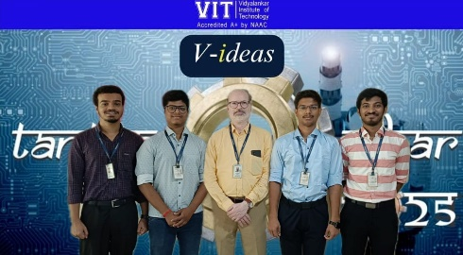
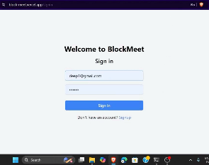
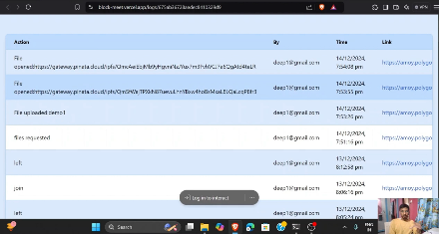
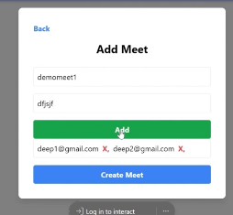
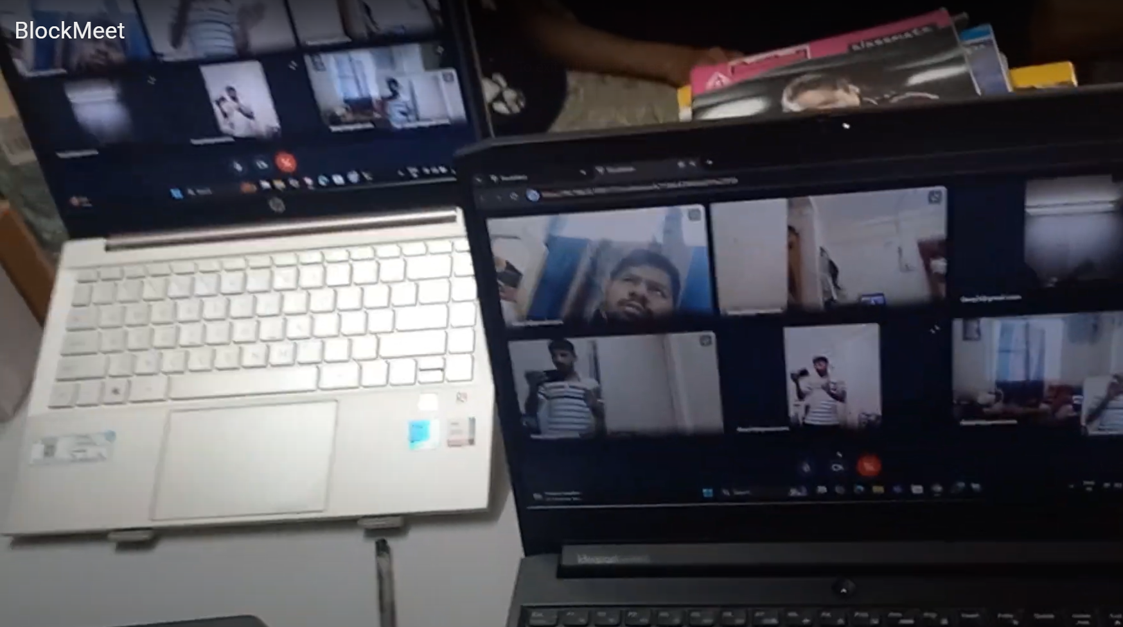
Department : Computer Engineering
Project Title : Block meet-Decentralized video conferencing solution
Domain (Area of Project) : Decentralized systems, WebRTC, Blockchain, IPFS
Name of Project Guide : Dr. Sachin Bojewar (sachin.bojewar@vit.edu.in)
Name of Students : Deep Salunkhe (deep.salunkhe@vit.edu.in)
Omkar Patil (omkar.patil@vit.edu.in)
Pranav Redij (pranav.redij@vit.edu.in)
Sukant Thombare (sukant.thombare@vit.edu.in)
Brief idea of Project : BlockMeet is a decentralised video conferencing application designed to overcome the privacy, scalability, and reliability issues found in traditional centralized platforms like Zoom or Google Meet. It uses WebRTC for peer-to-peer media streaming and follows a hydrocarbon-inspired architecture, where selected super-peers relay data without involving any central server. This ensures secure, private, and efficient group communication. Future upgrades include blockchain-based event logging, IPFS for decentralised file storage.
Screenshots of the Project / Photos of Working Model (Min.3):
Applications :
Privacy-respecting online meetings.
Corporate communication for sensitive discussions.
Decentralised team collaboration for startups or NGOs.
Educational platforms requiring secure and scalable meet.
Adapted for doctor-patient consultations with strong data privacy guarantees..

